Slide 2



Quick look: The benefits of Windows Services
Ian Barker
Embarcadero Delphi MVP
ian.barker@gmail.com
@punctuation
about.me/IanBarker
Slides, link & replay tinyurl.com/delphiqlservices

Slide 3
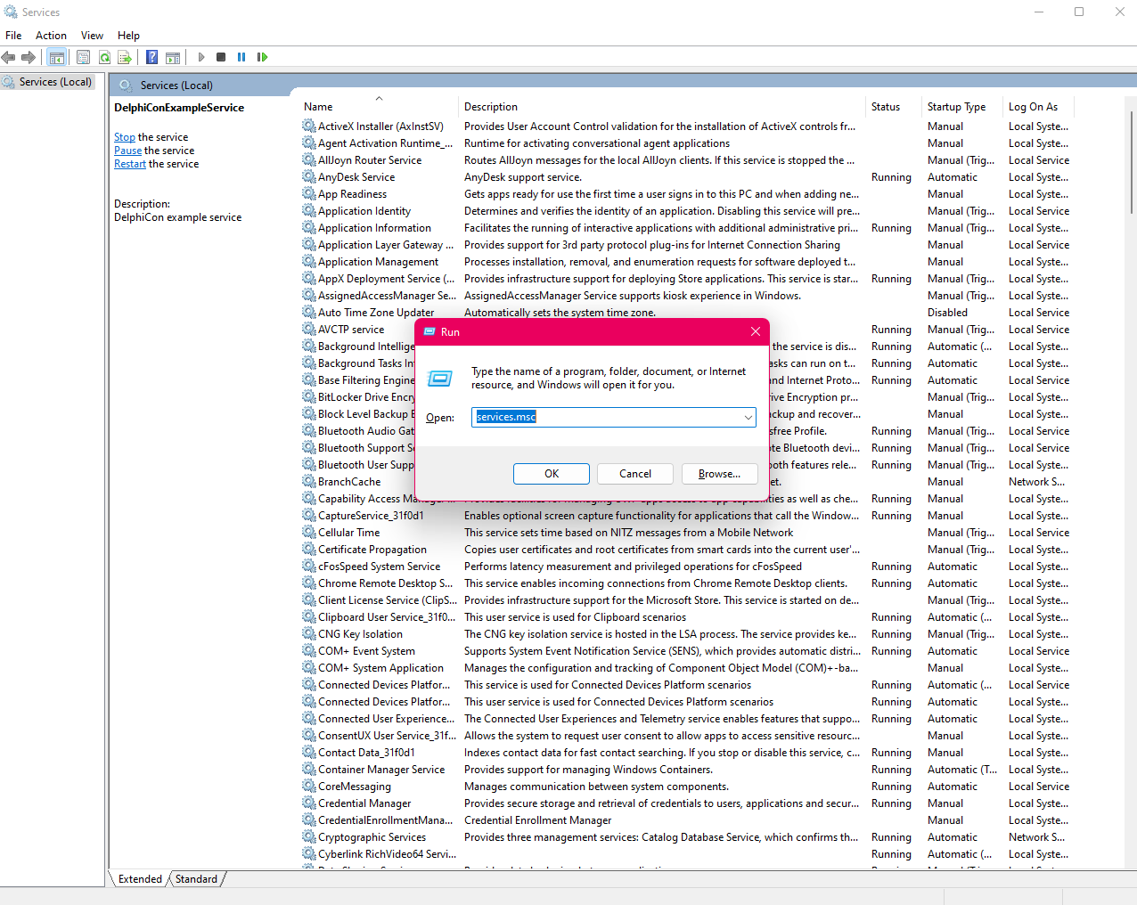
Windows services are GREAT if you have a use for them They can run even when the user is logged out They are especially useful for activities which need to run on a server without any direct user interactions
Quick look: The benefits of Windows Services

Slide 4
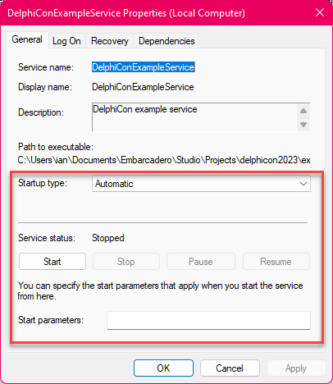
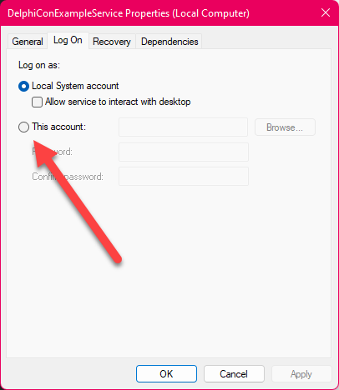
You can get them to launch automatically when the computer starts (this is the default) Or they can be made to launch manually
Quick look: The benefits of Windows Services
By default they run as a ‘fake’ user called the ‘service user’ but you can override that

Slide 5
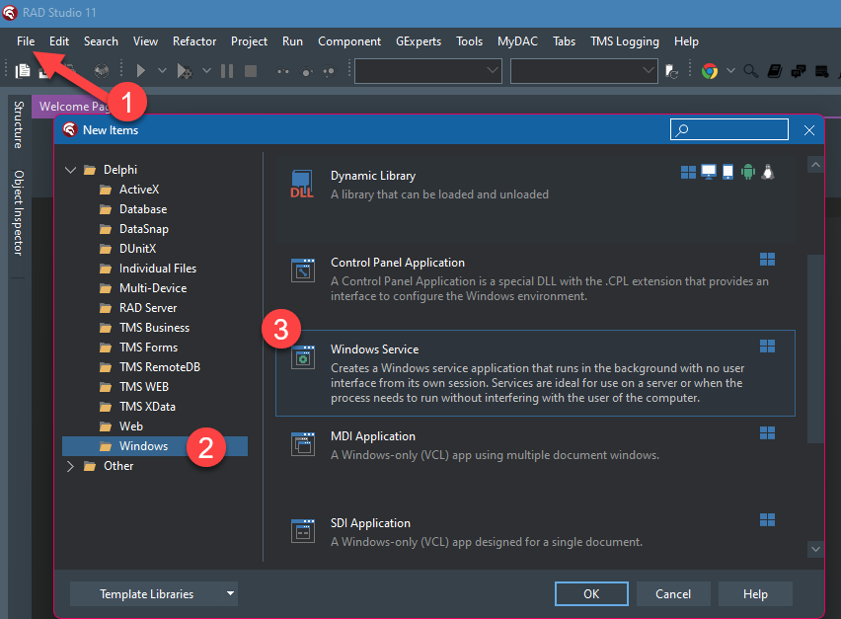
You can create one really easily with RAD Studio Select file, new, Windows, Windows service
Quick look: The benefits of Windows Services

Slide 6
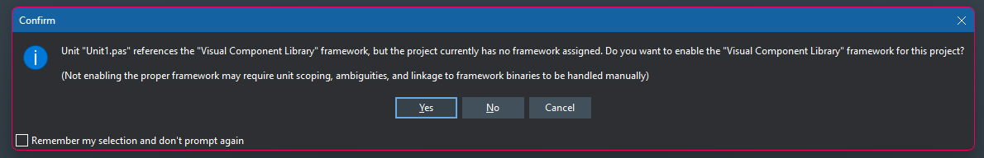
Just say “yes” to this message – it’s asking you if you want to use the VCL You do!
Quick look: The benefits of Windows Services

Slide 7
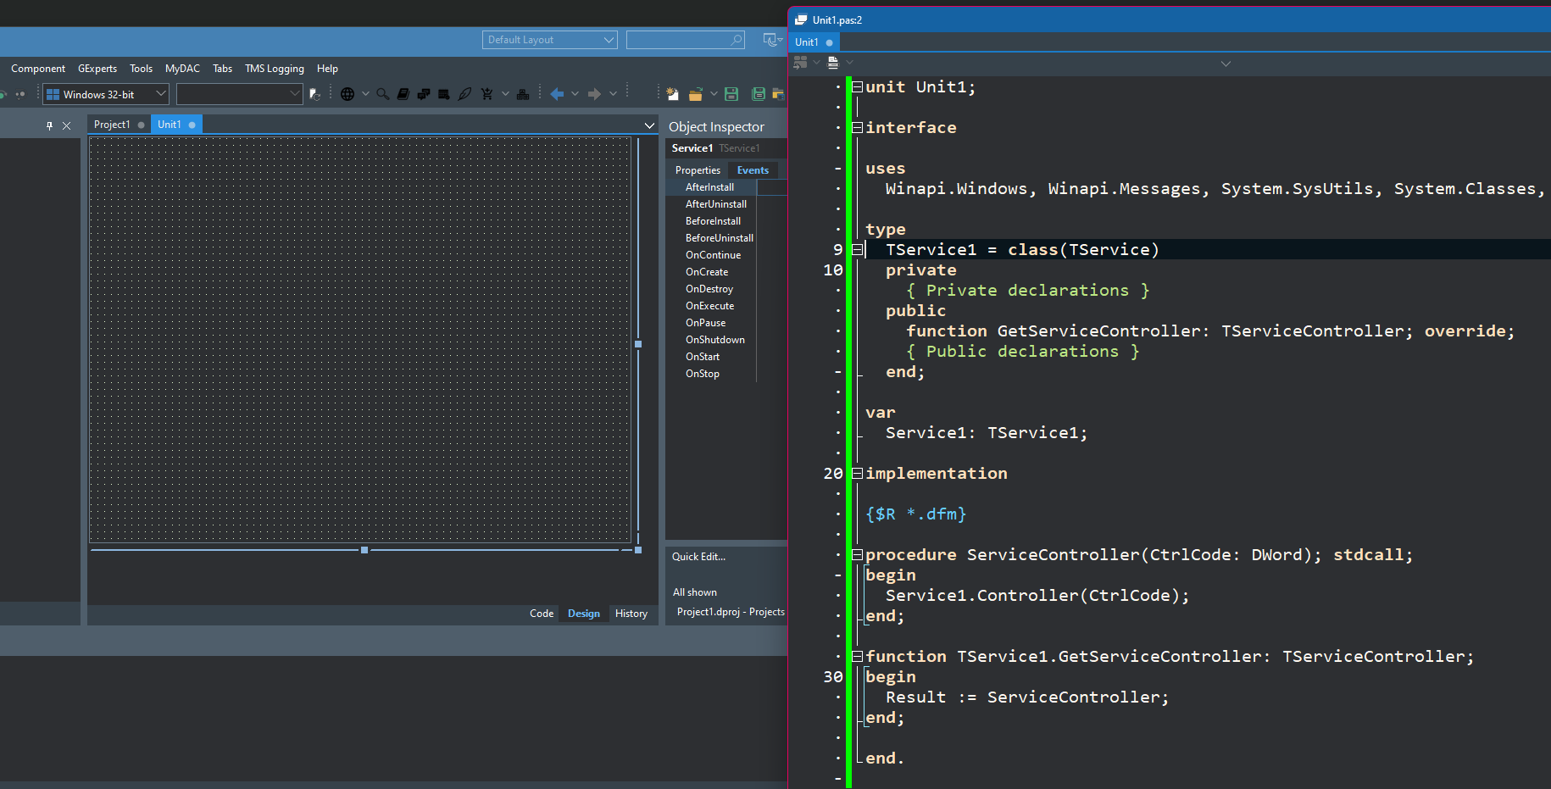
The wizard will create an ‘empty’ Windows service It has basic service functionality but doesn’t really do much
Quick look: The benefits of Windows Services

Slide 8
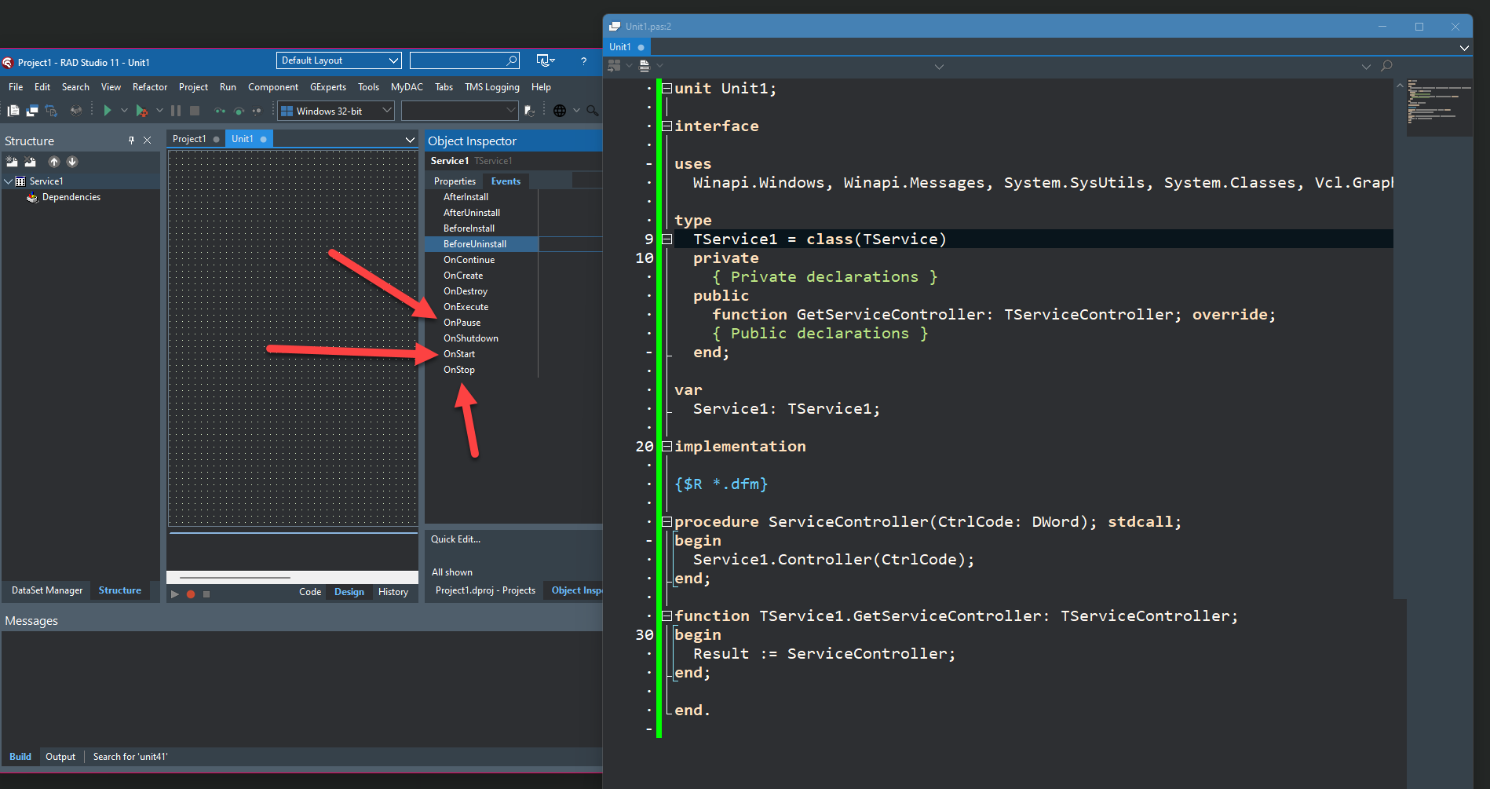
The key unit is the one with the TService in it The OnStart, OnStop, OnExecute, and OnPause events are what you’ll need most
Quick look: The benefits of Windows Services

Slide 9
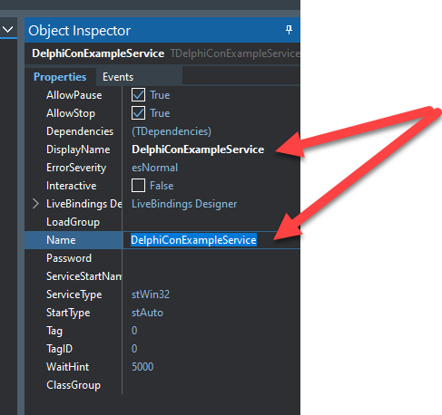
Pro tip: Change the name and the DisplayName of the service so you can identify it in the Windows service manager
Quick look: The benefits of Windows Services

Slide 10
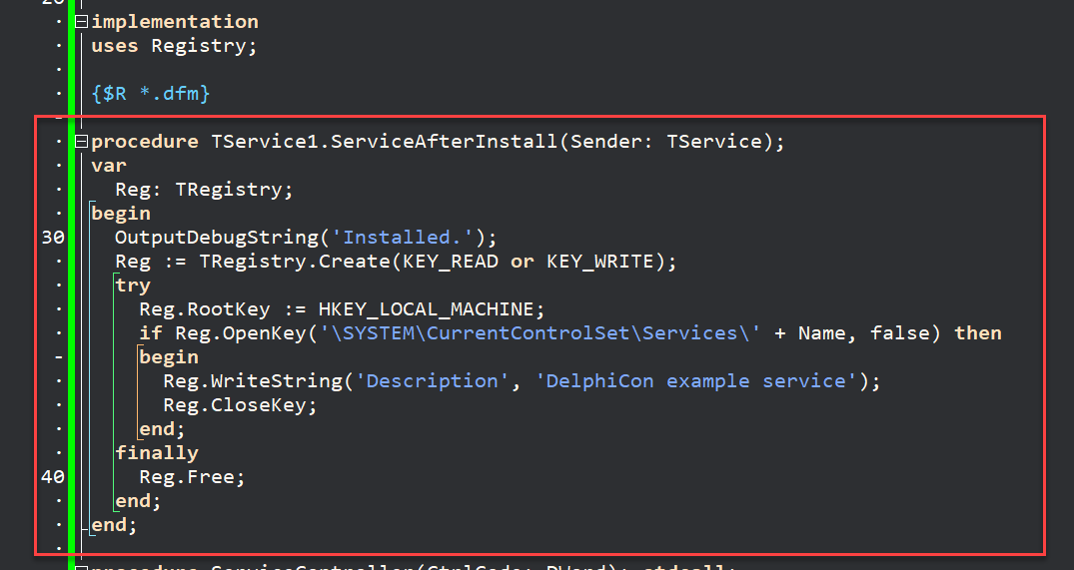
Add this code to the OnAfterInstall event so that your service shows a description in the service manager listing
Quick look: The benefits of Windows Services

Slide 11
Add this code to the OnAfterInstall event so that your service shows a description in the service manager listing
Quick look: The benefits of Windows Services

Slide 12
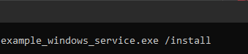
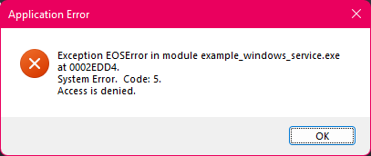
On most Windows systems you need to install the service as Administrator or you will get an error message
Quick look: The benefits of Windows Services

Slide 13
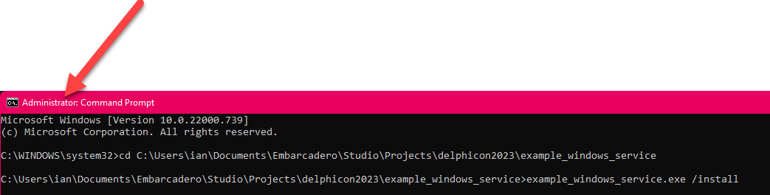
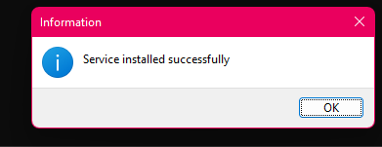
Do it like this
Quick look: The benefits of Windows Services

Slide 14
Quick look: The benefits of Windows Services
Arguments are:
/INSTALL
/UNINSTALL
/SILENT (paired with the above)

Slide 15
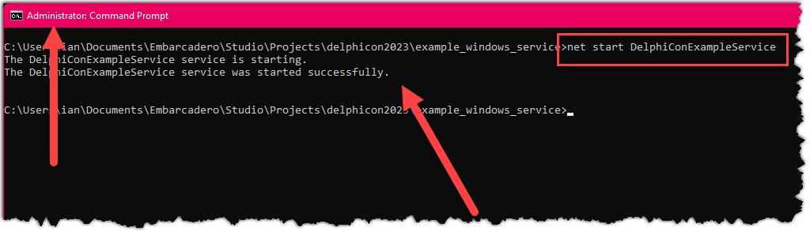
Quick look: The benefits of Windows Services
To start it running manually, use NET START THESERVICENAME

Slide 16
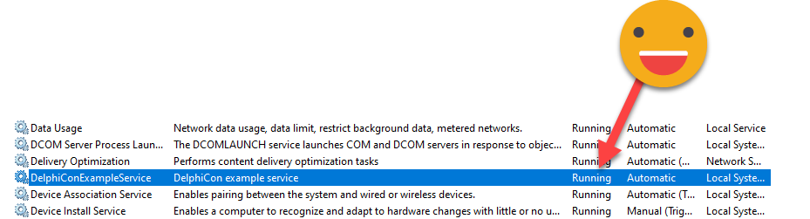
Quick look: The benefits of Windows Services
To start it running manually, use NET START THESERVICENAME

Slide 17
Quick look: The benefits of Windows Services
To get some feedback use your favorite logging service such as LoggerPro from MVP Daniele Teti: https://github.com/danieleteti/loggerpro
Or Grijjy https://github.com/grijjy/GrijjyCloudLogger
Or use the TService.LogMessageMethod which will emit to the Windows Event Log

Slide 18
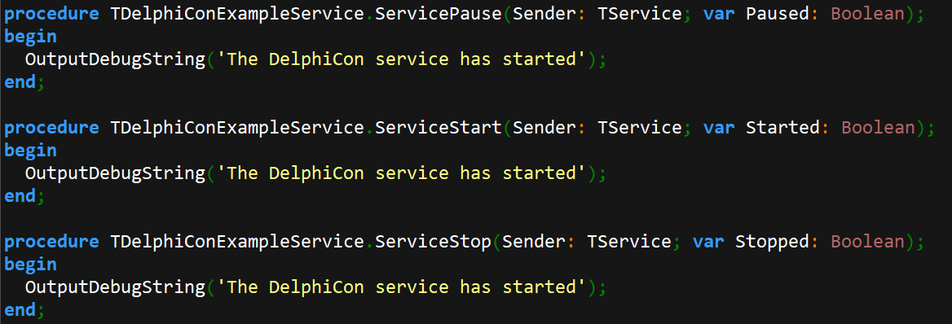
Quick look: The benefits of Windows Services
Or use OutputDebugString which will print to the Debug Console

Slide 19
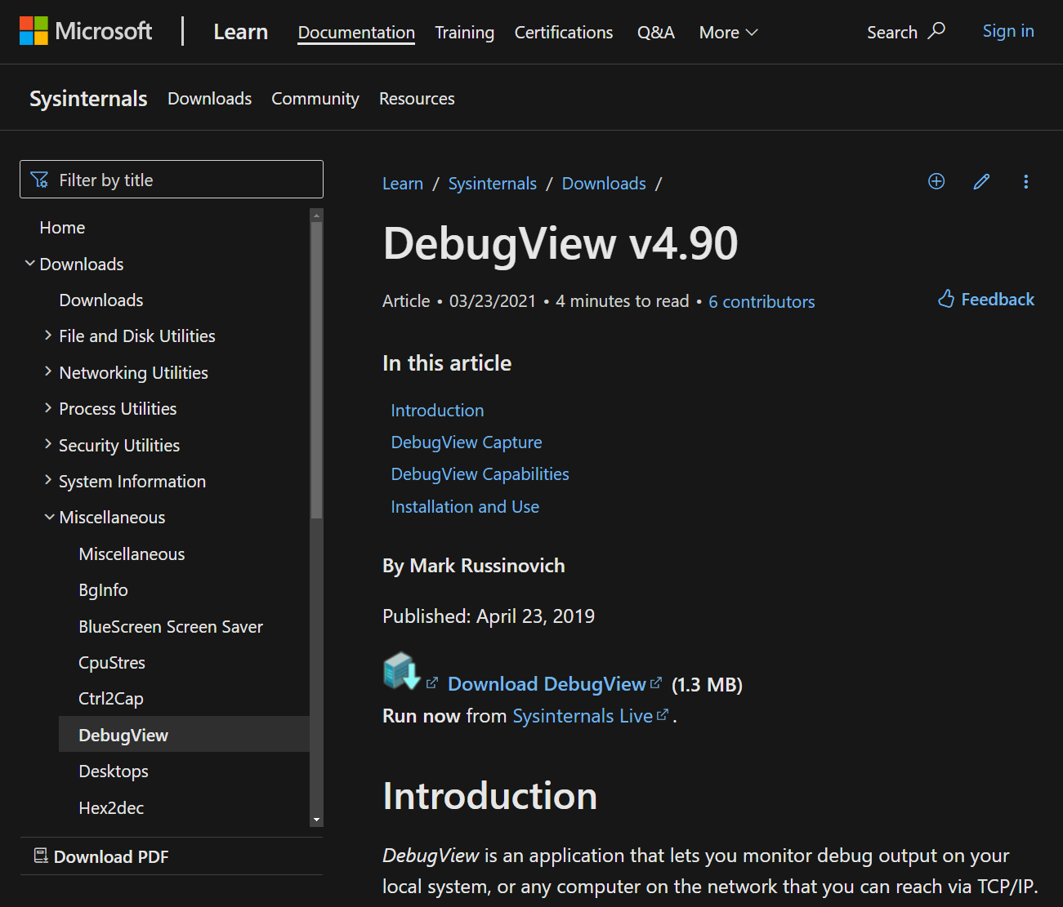
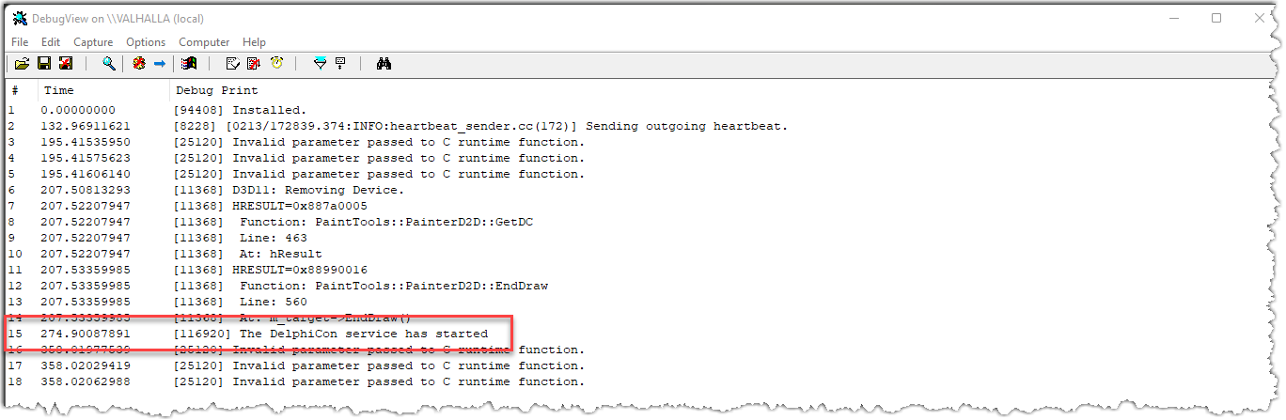
Quick look: The benefits of Windows Services
Use SysInternals’ excellent DebugView app to see all the debug console output
https://learn.microsoft.com/en-us/sysinternals/downloads/debugview

Slide 20



RAD Studio
There is NOTHING you can’t do using RAD Studio with Delphi
Run your apps on a Raspberry Pi? There is a solution for that, and it works today.
Run on a cheap Amazon Fire tablet? Target Android – it will run just fine!
Target Windows, macOS (Intel and Arm), iOS, Android, even the web from a SINGLE code base and project? Yes, it’s absolutely a fact
Keep running even after the whole operating system has been upgraded without needing any new downloads or reconfiguration? Yes.
That’s why I choose Delphi

Slide 21
Quick look: The benefits of Windows Services
Ian Barker
Embarcadero Delphi MVP
ian.barker@gmail.com
@punctuation
about.me/IanBarker
Slides, link & replay tinyurl.com/delphiqlservices

